Slide 1

Capstone Project: E-Commerce Market Mix Modeling
Hritike singh rawat
EPG C31

Slide 2
Root Cause Analysis:

Slide 3
SPIN Framework:
Situation | Problem
🞆 Low order conversion rate | 🞆 Higher number of products lying in the cart because of lower order conversion rate
No Mobile Application for shopping | No technical team to design the mobile application
Low average time spent in website | Low rating of website
Focusing more on existing customers than acquiring new customers | Not working in acquiring new customers
Customer retention | Existing customers are retaining
Implication | Need-Payoff
🞆 Certain items are reflected as out of stock, which adds another unhappy customer to the list | 🞆 More order conversion places the company in a better position to bargain with suppliers for better profit margins
Insufficient budget to hire a technical team | Mobile application interface and design be helpful and easily accessible for suppliers and customers
Website checkout and payment process is complex | Sales will be increased if these types of issue will be fixed
It takes huge investment in acquiring new customers | New customers should be acquired apart from focusing on existing customers to increase revenue and scalibility
Getting more rewards from competitor or not getting proper rewards for being loyal customers | Offering promo codes, cashbacks and free deliveries to existing customers

Slide 4
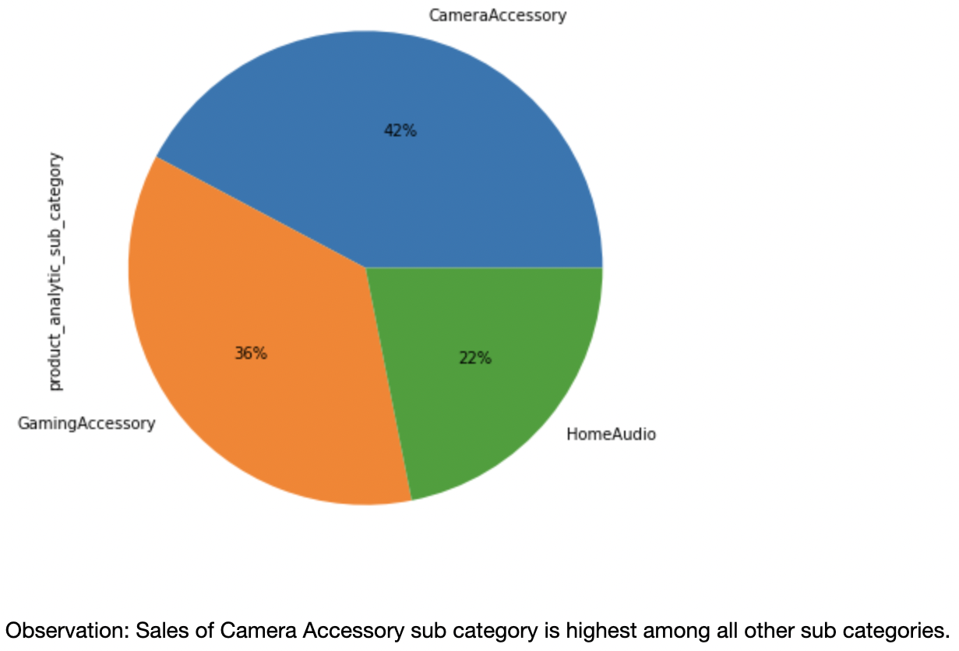
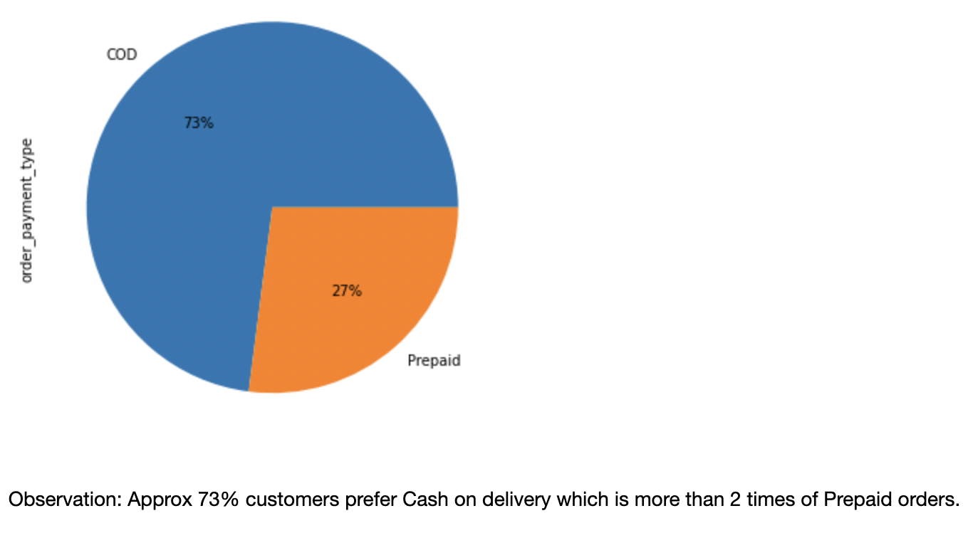
Exploratory Data Analysis:

Slide 5
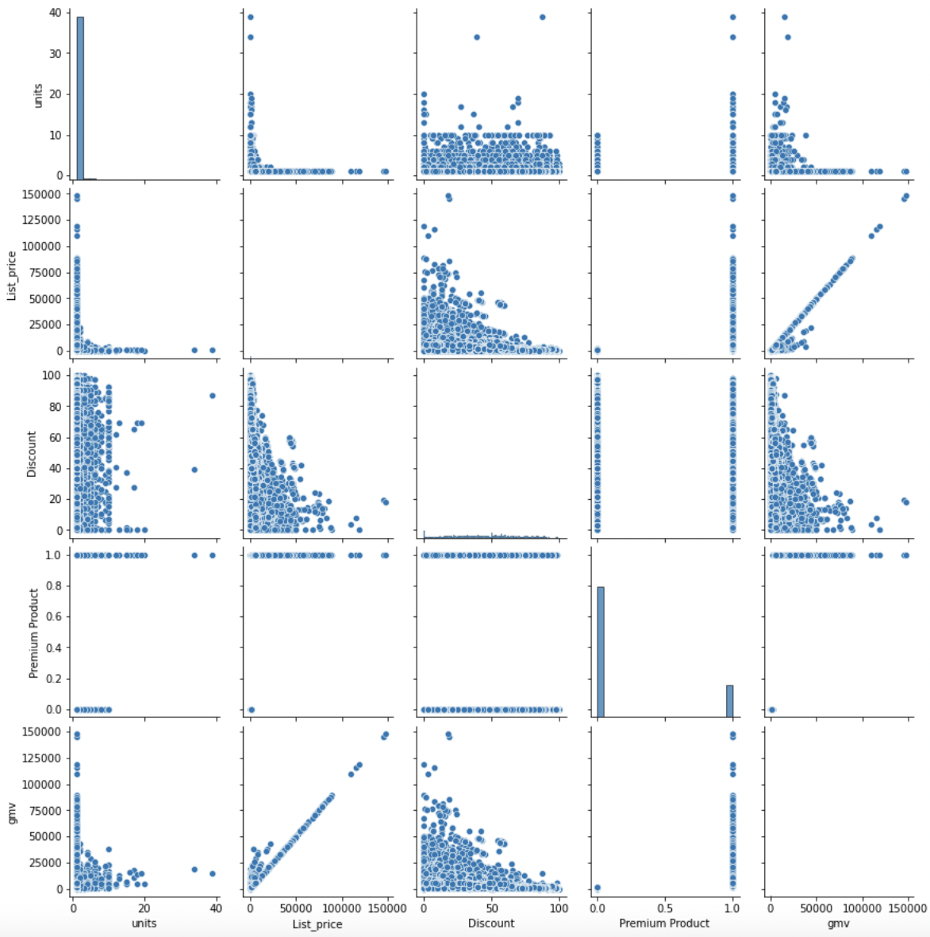
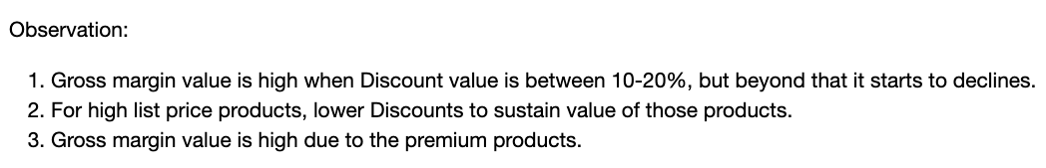

Slide 6
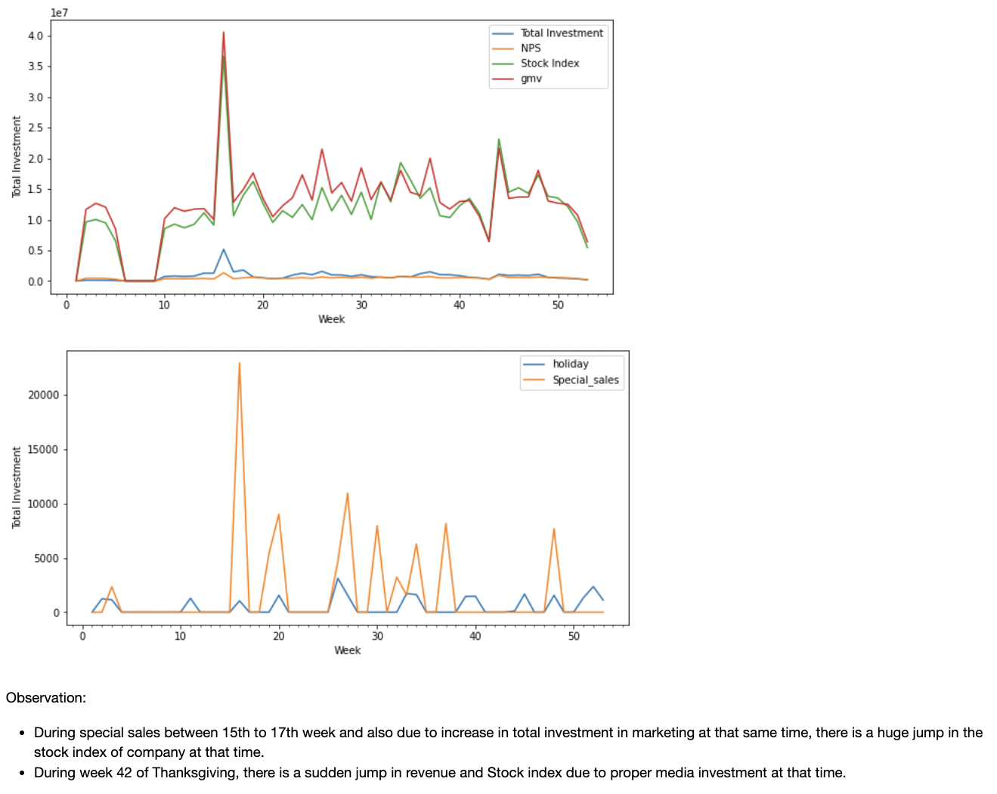

Slide 7
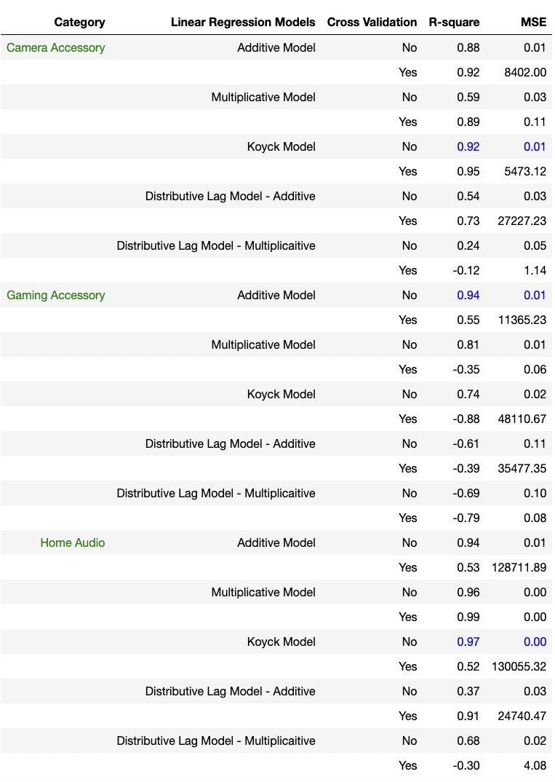
Model Selection

Slide 8
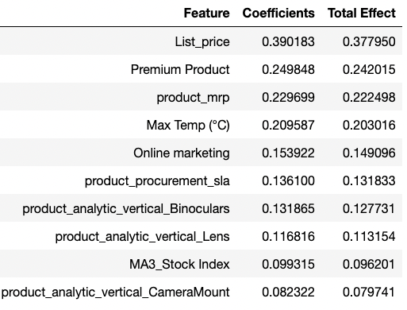
Camera Accessory Model

Slide 9
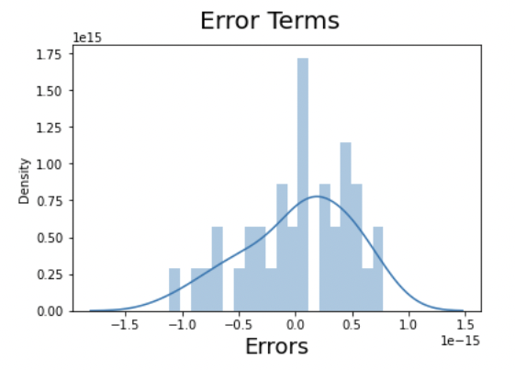
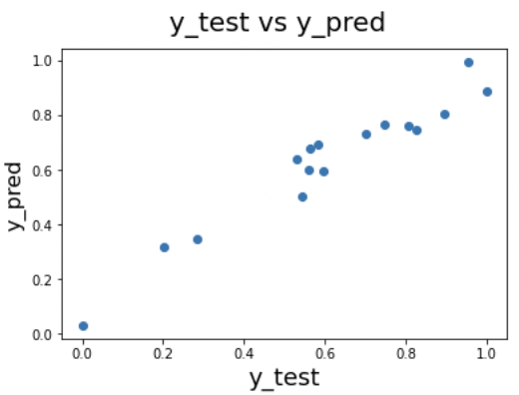

Slide 10
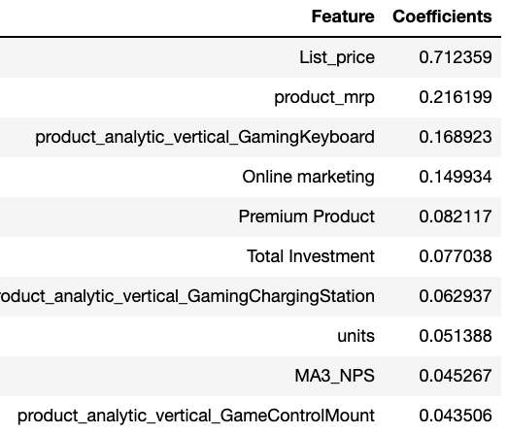
Gaming Accessory Model

Slide 11
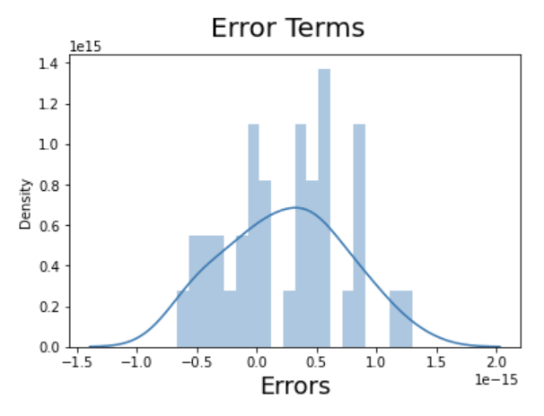
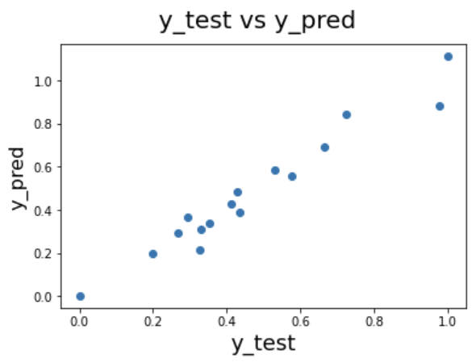

Slide 12
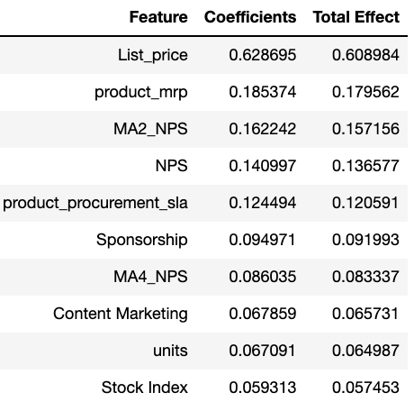
Home Audio Model

Slide 13
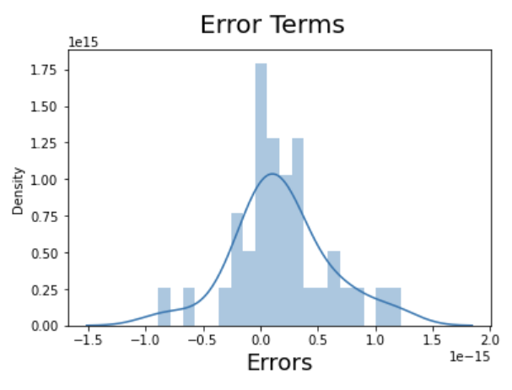
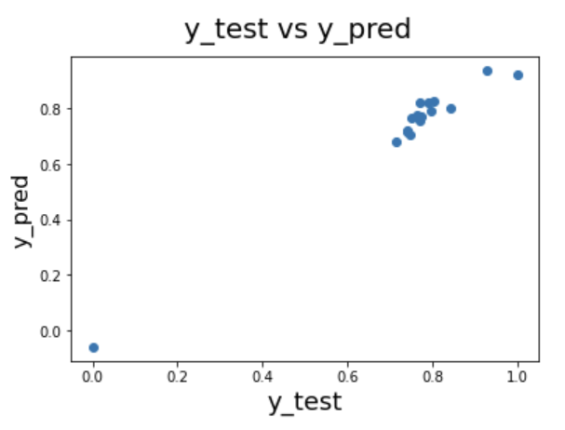

Slide 14
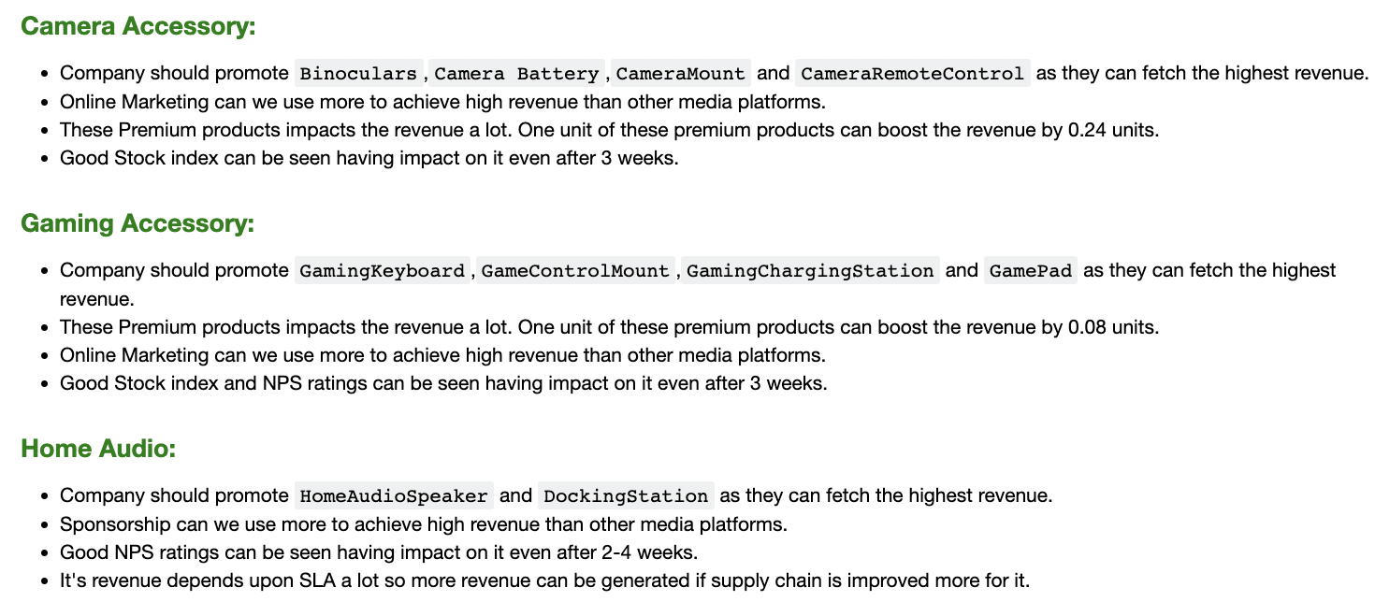
Recommendation:

Slide 15
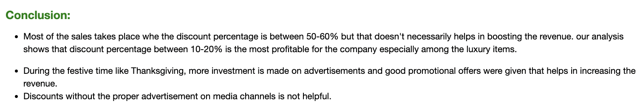
Conclusion:

Slide 16


